Slide 1
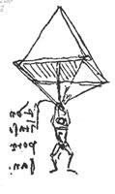
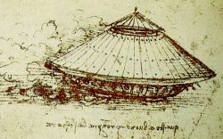
Golden Age of Islamic Philosophy
Dr. Allen Driggers
Department of History
Tennessee Technological University

Slide 2
Outline of Lecture
I plan on using historical case studies from the Golden Age of Islamic Philosophy through the Western Renaissance to discuss the complexity of the conveyance of knowledge.
This lecture will transition us to discussing Byzantine Empire, the European Renaissance, and Cathedral Engineering.
Question the framing of the Golden Age of Islamic Philosophy

Slide 3
Contextualizing Historical Terms
Ancient Greece (500-336 BCE [Before the Common Era*])
Golden Age of Islamic Philosophy (Circa 700 CE- 1300 BCE)
The Renaissance of Eastern and Western Europe (1300 CE-1650 CE)
The Renaissance meant “Re-Birth”

Slide 4
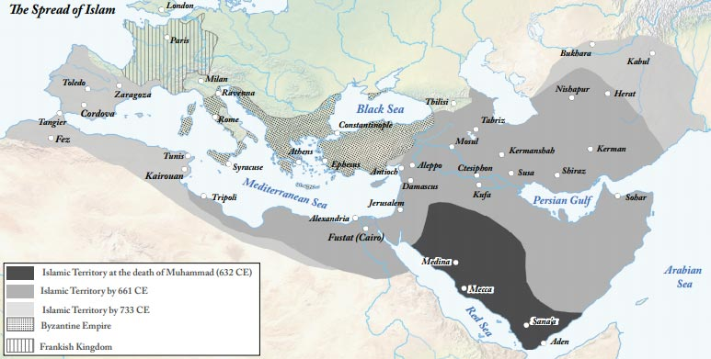
Islamic Era Maps #1

Slide 5
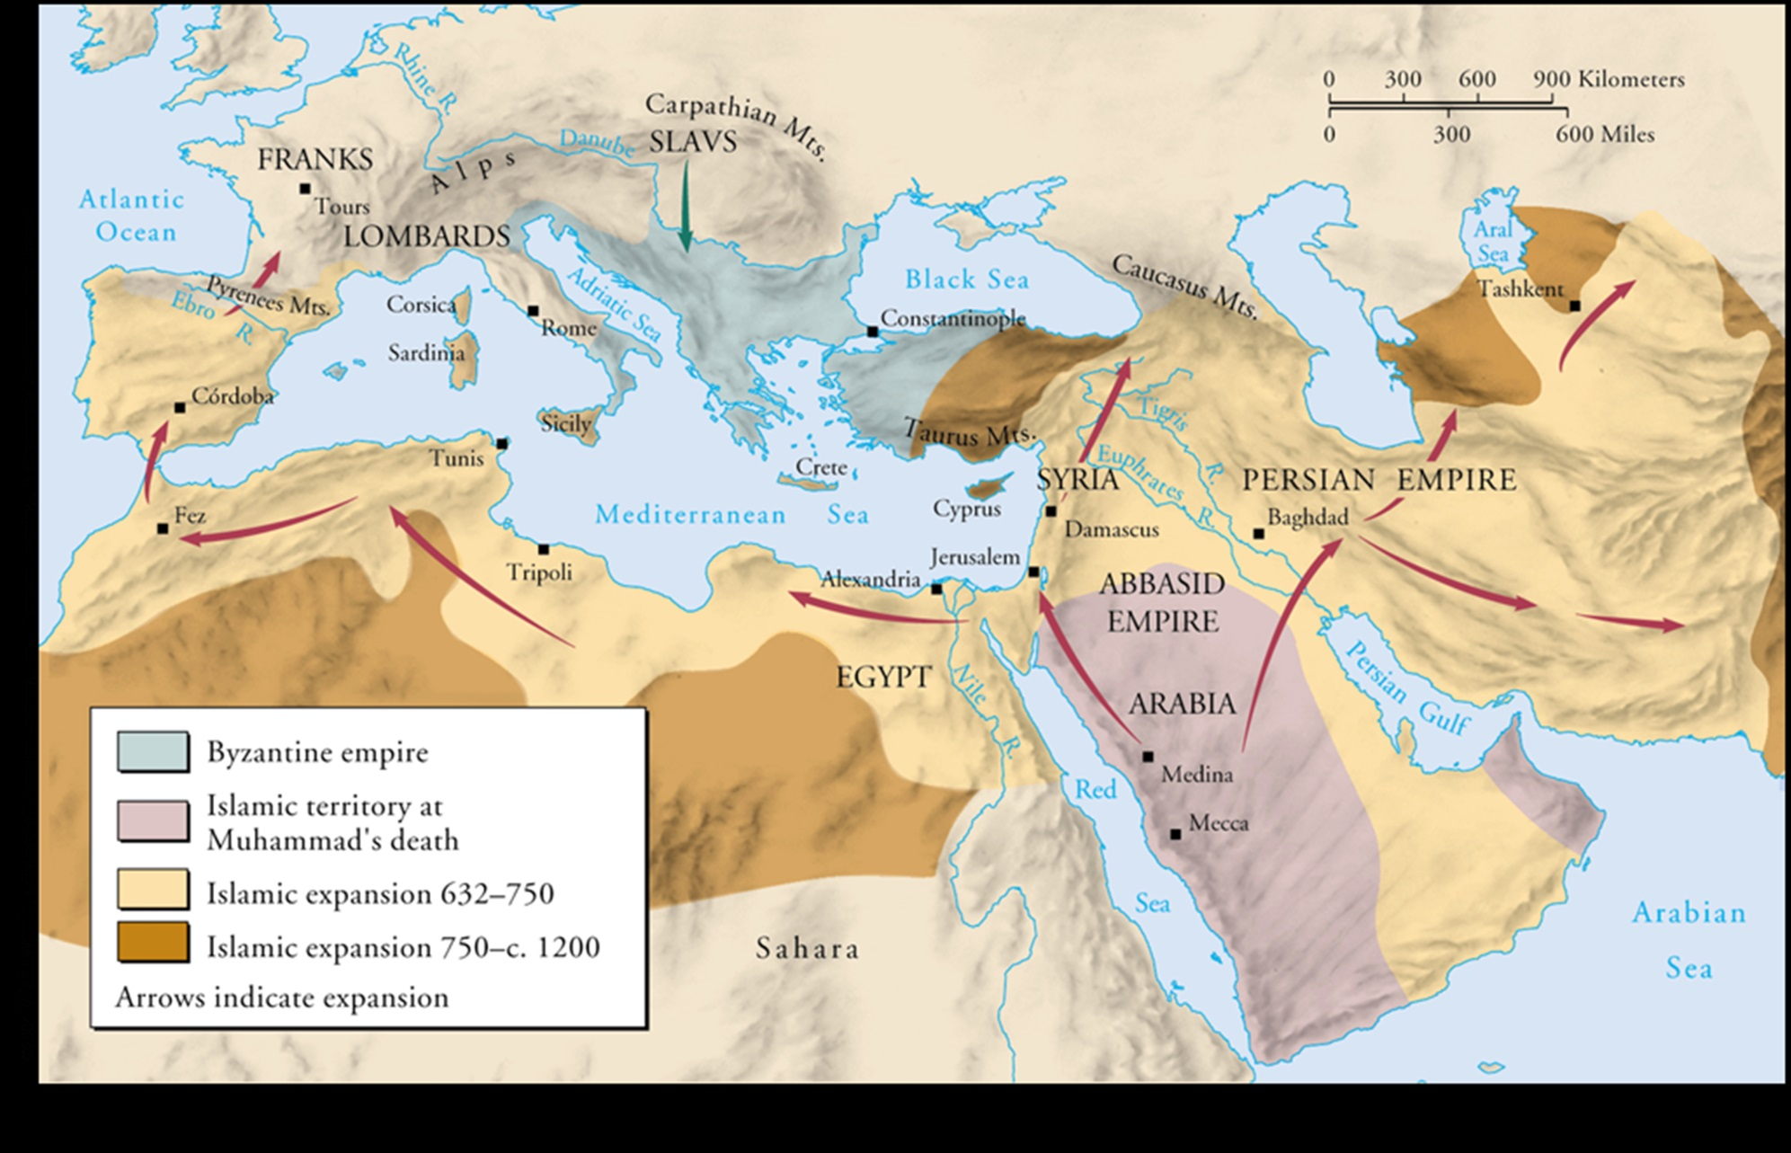
Islamic Era Map #2

Slide 6
Scientific Terms Originating and Appropriated from the Golden Age
Algebra
Alchemy
Elixir
Alcohol
Borax
Alkali
Algorithm

Slide 7
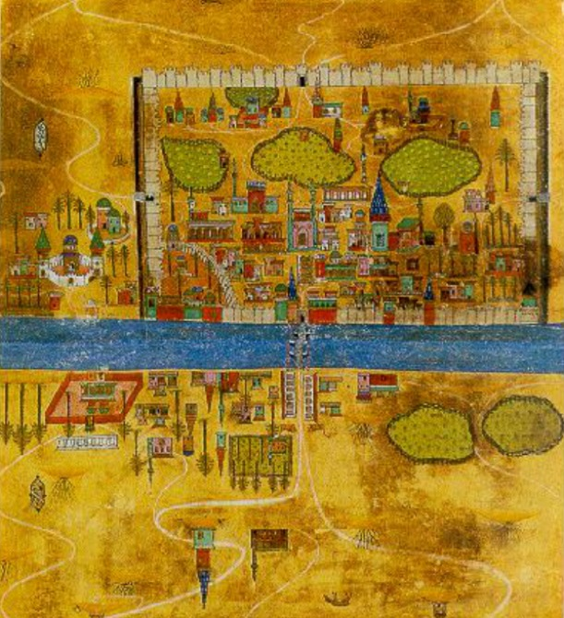
The Cities of the Golden Age
Irrigation and Prosperity
Relative city populations in a global comparisons

Slide 8
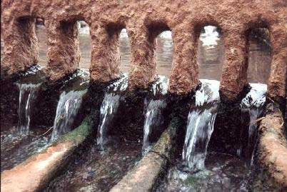
Hydraulic Technology—The Qanat

Slide 9
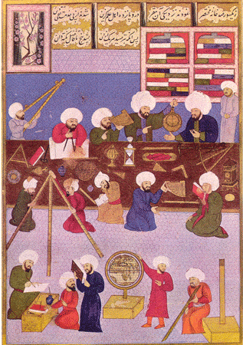
Transmission of Knowledge
A Literate Society
The many uses of scientific instruments
Case of the Astrolabe

Slide 10
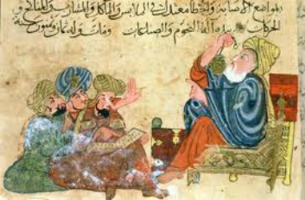
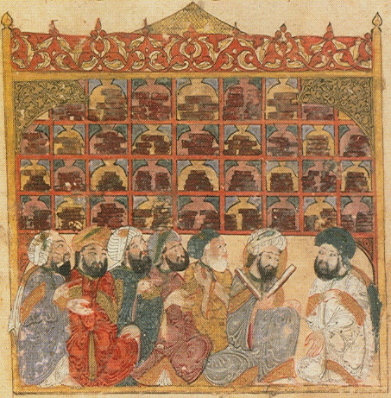
Houses of Wisdom

Slide 11
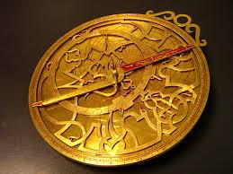
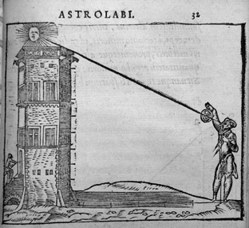
Astrolabe

Slide 12
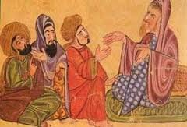
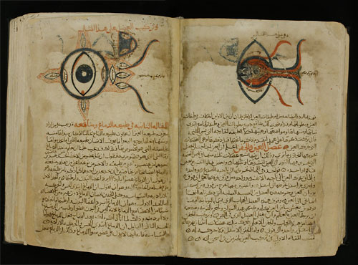
Hunayn ibn Ishaq (Latin Iohannitius)

Slide 13
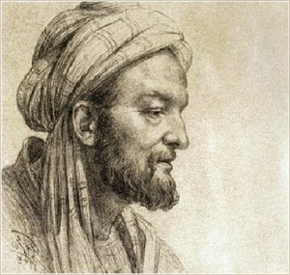
Avicenna
“Avicenna” is the Latinized name of the “Ibin Sinda”
Avicenna was a natural philosopher and a physician.
Avicenna wrote the “Book of Healing” and the “Cannon of Medicine”

Slide 14
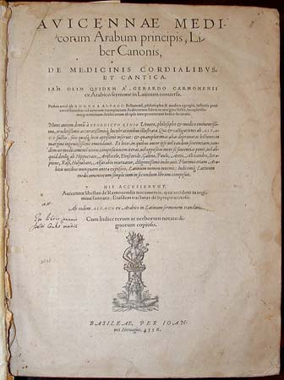
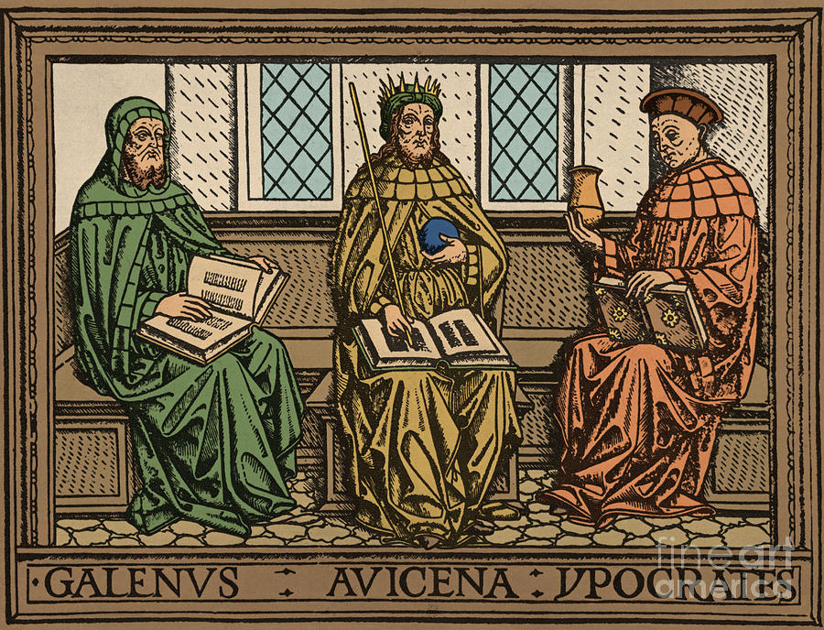
Avicenna and Medicine

Slide 15
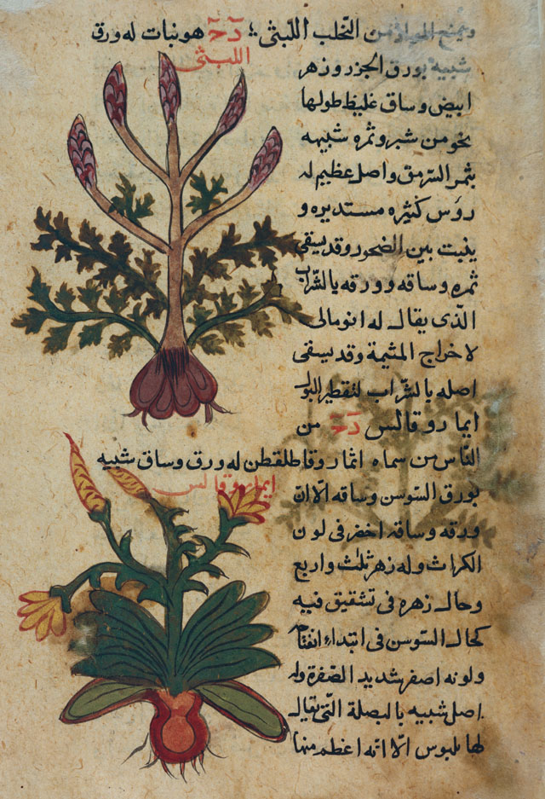
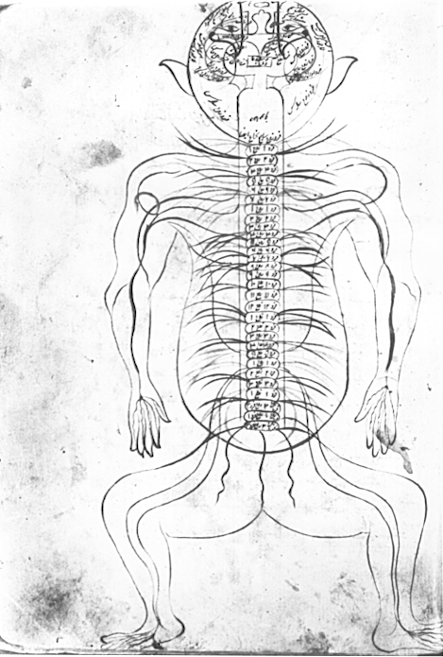
Medicine/Biology and Images 2

Slide 16
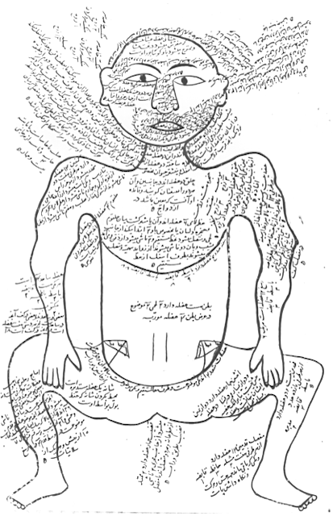
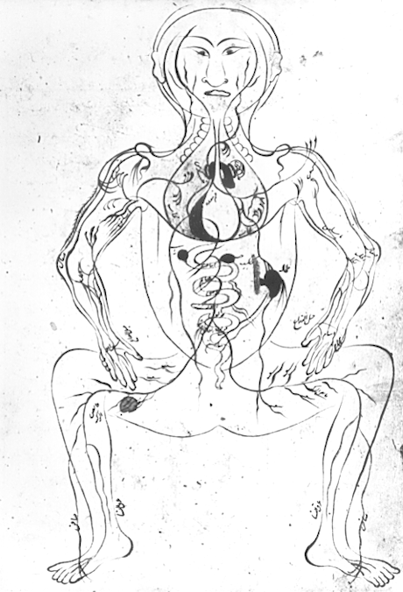
Medicine/Biology and Images 4

Slide 17
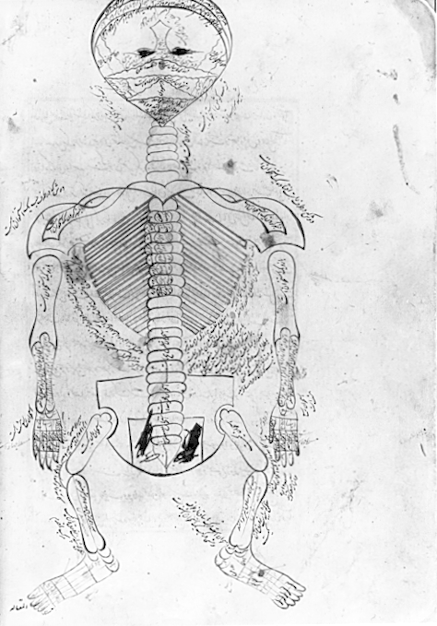

Slide 18
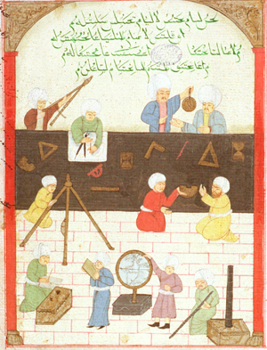

Slide 19
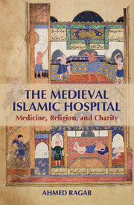
Centers of Learning
Law Centers
Hospitals

Slide 20
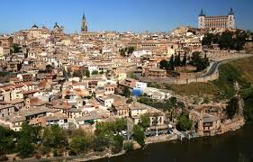
Toledo, Spain

Slide 21
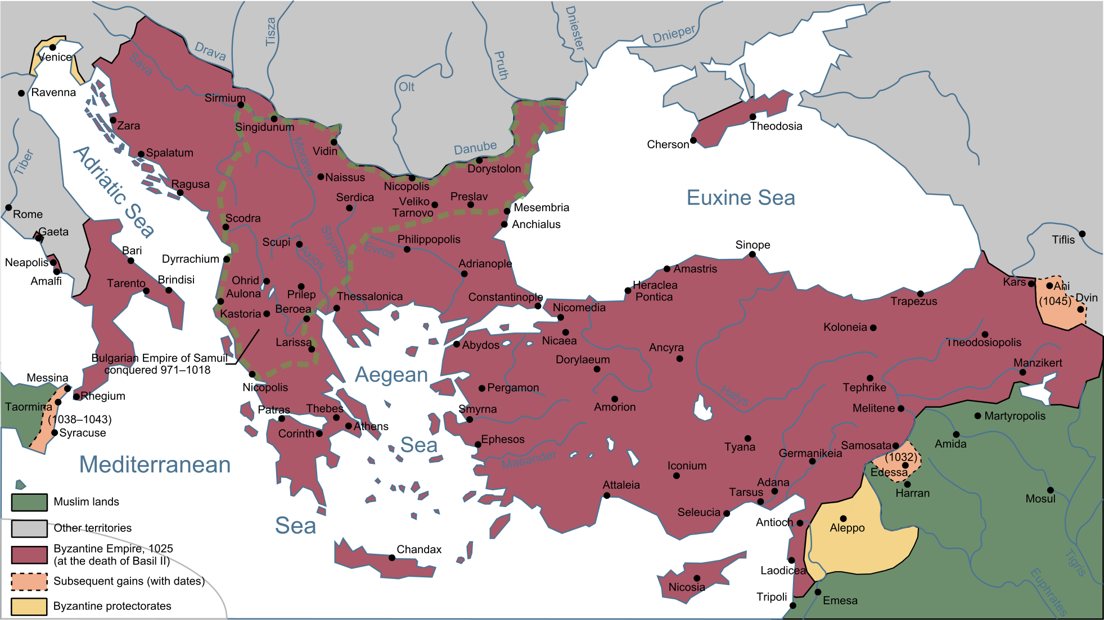
Byzantium 2

